Slide 1




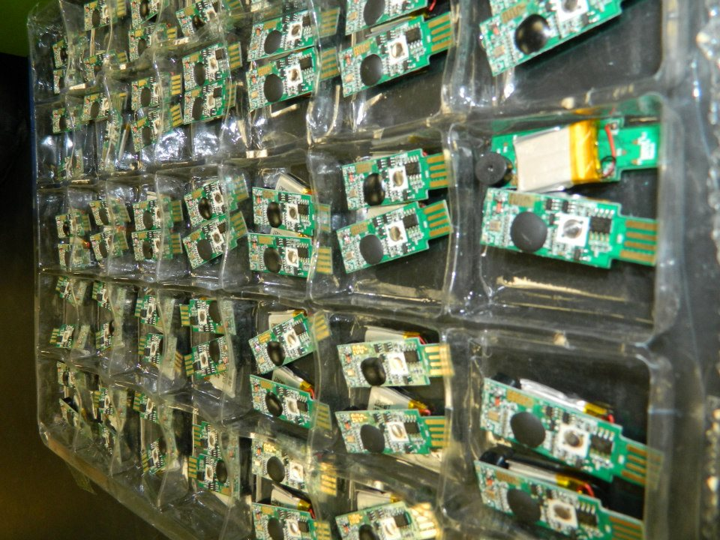
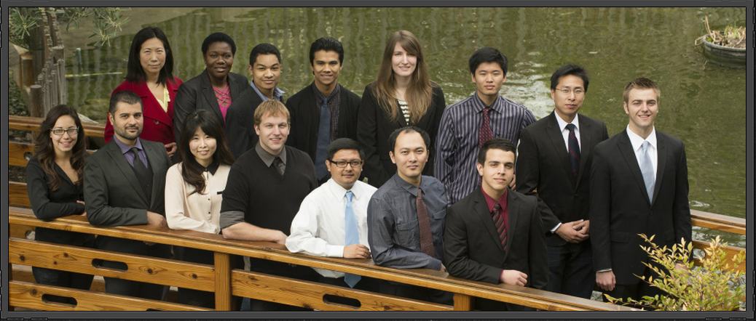
Poly Presents: Blu-Finder
Basic Design
Have plenty of white space
Use only 3 or 4 colors, including black, for text.
Use no more than 2 font families. Choose standards such as Arial, Verdana, and Times to avoid print substitution.
Use bold, italic, and underlining sparingly to emphasize a new idea or a heading.
Make text at least 24 point. People should be able to read text easily from at least 6 feet away.
Use short sentences and paragraphs.
Content
People decide in about 3 seconds whether to look at your poster. Make your title and headings interesting but not “cute.”
Tell a story – use headings to lead people through your chapters.
Focus on your major points and do not try to include too much information.
Use simple language and define all technical terms. In other words, avoid jargon.
Printing
Use a white background to save ink and reduce visual distraction.
Proofread carefully.
Save your poster as a pdf to reduce printing errors.
Print early – don’t wait until the last minute
Graphics or Art
Use graphics or pictures to add significant information or relevant visual interest. Do not use clip art, which tends to be generic.
Use only materials that you have permission to use; i.e., do not violate copyright laws.
Use high quality graphics, 100-300 dpi.
Nice Additions
Print miniature copies of your poster for people to take.
Have a pad of paper and a pencil by your poster for people to leave a note.

